Slide 1
Behavioral & Structural Implementation using VERILOG

Slide 2
Description Styles (cont.)
Behavioral: Algorithmically specify the behavior of the design
Example:
if (select == 0) begin
out = b;
end
else if (select == 1) begin
out = a;
end
a
Black Box
2x1 MUX
out
b
sel

Slide 3
Behavioral Modeling
Example:
  module mux_2x1(a, b, sel, out);
  input a, b, sel;
  output out;
  always @(a or b or sel)
  begin
  if (sel == 1)
  out = a;
  else out = b;
  end
  endmodule
Sensitivity List

Slide 4
Behavioral Modeling (cont.)
always statement : Sequential Block
Sequential Block: All statements within the block are executed sequentially
When is it executed?
  Occurrence of an event in the sensitivity list
  Event: Change in the logical value
Statements with a Sequential Block: Procedural Assignments
Delay in Procedural Assignments
  Inter-Statement Delay
  Intra-Statement Delay

Slide 5
Procedural Constructs
Two Procedural Constructs
  initial Statement
  always Statement
initial Statement : Executes only once
always Statement : Executes in a loop
Example:
  …
  initial begin
  Sum = 0;
  Carry = 0;
  end
  …
  …
  always @(A or B) begin
  Sum = A ^ B;
  Carry = A & B;
  end
  …

Slide 6
Loop Statements
Loop Statements
  Repeat
  While
  For
Repeat Loop
  Example:
    repeat (Count)
    sum = sum + 5;

Slide 7
Loop Statements (cont.)
While Loop
  Example:
    while (Count < 10) begin
    sum = sum + 5;
    Count = Count +1;
    End
For Loop
  Example:
    for (Count = 0; Count < 10; Count = Count + 1) begin
    sum = sum + 5;
    end

Slide 8
Conditional Statements
Example:
    if (Clk)
    Q = 0;
    else
    Q = D;
if Statement
Format:
  if (condition)
  procedural_statement
  else if (condition)
  procedural_statement
  else
procedural_statement

Slide 9
Conditional Statements (cont.)
Case Statement
Example 1:
    case (X)
    2’b00: Y = A + B;
    2’b01: Y = A – B;
    2’b10: Y = A / B;
    endcase
Example 2:
case (3’b101 << 2)
3’b100: A = B + C;
4’b0100: A = B – C;
5’b10100: A = B / C; //This statement is executed
endcase

Slide 10
Example Problems

Slide 11
2-to-1 Multiplexer
s
s
f
w
0
0
0
w
w
f
0
1
1
1
w
1
(a) Graphical symbol
(b) Truth table
w
0
s
f
w
1
(c) Sum-of-products circuit

Slide 12
s
0
s
1
s
1
s
0
f
w
0
00
0
0
w
0
w
1
01
f
0
1
w
1
w
2
10
1
0
w
w
3
11
w
2
1
1
3
(a) Graphic symbol
(b) Truth table
s
0
w
0
s
1
w
1
f
w
2
w
3
(c) Circuit

Slide 13
Coding
module mux4( select, d, q );
input[1:0] select;
input[3:0] d;
output q;
reg q;
wire[1:0] select;
wire[3:0] d;
always @( select or d ) begin
if( select == 0)
q = d[0];
if( select == 1)
q = d[1];
if( select == 2)
q = d[2];
if( select == 3)
q = d[3];
end
endmodule

Slide 14
Using Case
module mux4( select, d, q );
input[1:0] select;
input[3:0] d;
output q;
reg q;
wire[1:0] select;
wire[3:0] d;
always @( select or d )
begin
case( select )
0 : q = d[0];
1 : q = d[1];
2 : q = d[2];
3 : q = d[3];
endcase
end
endmodule

Slide 15
2-to-4 Decoder
En
w
1
w
0
y
3
y
2
y
1
y
0
w
1
y
3
1
0
0
0
0
0
1
w
y
1
0
1
0
0
1
0
0
2
1
1
0
0
1
0
0
y
1
1
1
1
1
0
0
0
En
y
0
0
-
-
0
0
0
0
(a) Truth table
(b) Graphical symbol
w
0
y
0
w
1
y
1
y
2
y
3
En
(c) Logic circuit

Slide 16
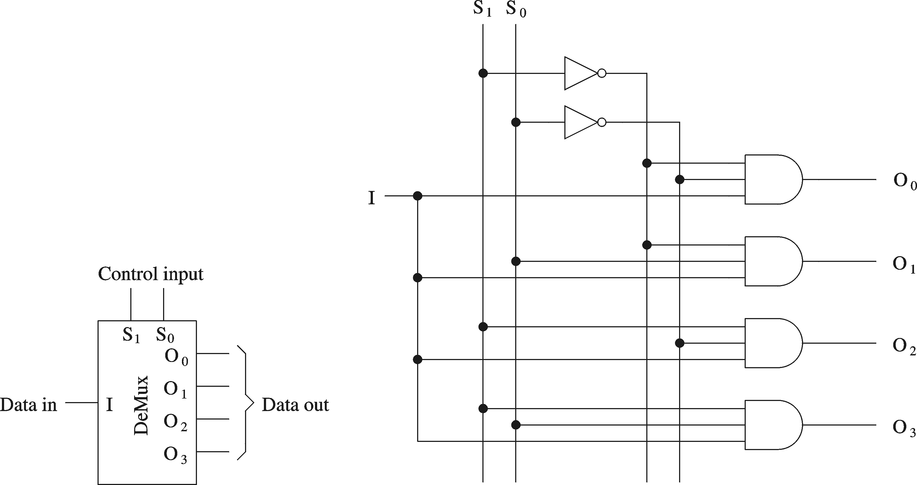
1-to-4 Demultiplexer

Slide 17
D Latch
D
Q
always@(clock)
begin
if (clock==1)
Q = D ;
End
Clock

Slide 18
D Flip-Flop
D
Q
Clock
always@(posedge clock)
begin
Q =D ;
End

Slide 19
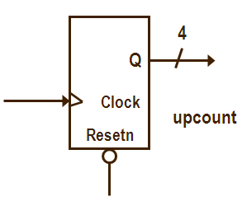
4-bit up-counter with synchronous reset
always@(posedge clk)
begin
if (reset==1)
count=0;
else
count=count+1;
End

Slide 20
Structural Implementation Using VERILOG

Slide 21
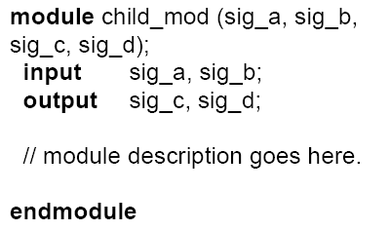
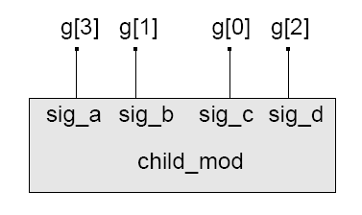
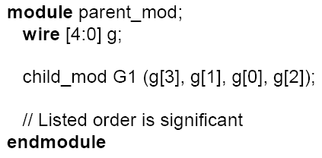
Type of Port Connections
Connection by Position
parent_mod

Slide 22
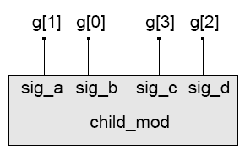
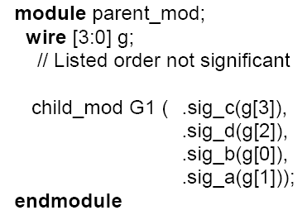
Type of Port Connections (cont.)
Connection by Name
parent_mod

Slide 23
Empty Port Connections
If an input port of an instantiated module is empty, the port is set to a value of z (high impedance).
module child_mod(In1, In2, Out1, Out2) module parent_mod(…….)
input In1;
input In2; child_mod mod(A, ,Y1, Y2);
output Out1; //Empty Input
output Out2; endmodule
//behavior relating In1 and In2 to Out1
endmodule
If an output port of an instantiated module is left empty, the port is considered to be unused.
module parent_mod(…….)
child_mod mod(A, B, Y1, ); //Empty Output
endmodule

Slide 24
Example – 1 : Implement Full adder By structural approach
x
sum
y
Full Adder
cout
cin

Slide 25

Inside the Black box
a
sum
x
s
s
HA1
a
b
c
y
HA2
c
Full Adder
b
cout
cin

Slide 26
Example 2 – Counter with clock selector
reset
Clk0
Clk1
mux
counter
count
Clk2
Clk3
cs1
cs0

Slide 27
Test Bench
`timescale 1ns/100ps
module Top;
reg PA, PB;
wire PSum, PCarry;
HalfAdder G1(PA, PB, PSum, PCarry);
initial begin: LABEL
reg [2:0] i;
for (i=0; i<4; i=i+1) begin
{PA, PB} = i;
#5 $display (“PA=%b PB=%b PSum=%b PCarry=%b”, PA, PB, PSum, PCarry);
end // for
end // initial
endmodule
Test Bench
Apply Inputs
Design
Module
Observe Outputs

Slide 28
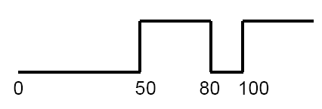
Test Bench - Generating Stimulus
Example: A sequence of values
  initial begin
  Clock = 0;
  #50 Clock = 1;
  #30 Clock = 0;
  #20 Clock = 1;
  end

Slide 29
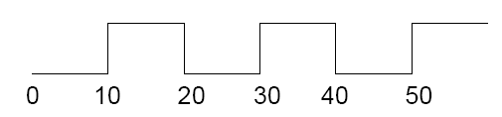
Test Bench - Generating Clock
Repetitive Signals (clock)
Clock
A Simple Solution:
  wire Clock;
  assign #10 Clock = ~ Clock
Caution:
  Initial value of Clock (wire data type) = z
  ~z = x and ~x = x

Slide 30
Test Bench - Generating Clock (cont.)
Initialize the Clock signal
    initial begin
    Clock = 0;
    end
Caution: Clock is of data type wire, cannot be used in an initial statement
Solution:
    reg Clock;
    …
    initial begin
    Clock = 0;
    end
    …
    always begin
    #10 Clock = ~ Clock;
    end
forever loop can
also be used to
generate clock

